Slide 1
Food Business Critical Analysis
Sudhir Singh

Slide 2
Research And Analysis Description
Problem Statement- A man has took a shop in Rent near BTM Layout, Bangalore, not in the main road but as a local shop. The rent of the shop is 14000 per month. The man took the shop to sell fast food like - Biryani, Maggie, Egg Bhujia, Omlets, Chicken Kabab etc.
a. In the first 3 months he make a profit of around 100000, with a sales of around 300000.
b. In the 1st month he was selling veg food also, but he stopped after the 2nd month as it stock was not getting out.
c. After 4 – 5 months down the line the man is making a huge loss in his investment.
He has a due of 2 months to pay the rent.
d. The sale has drastically gone down and he is thinking to close the shop.
e. The Man is very lazy in working hard and also very poor in any other investment. Data is collected from different resources and is analyzed on various scales to find the optimal solution.

Slide 3
Objectives and Methodology
To find out the factors responsible for the sale loss.
To find out the type of foods which give the maximum revenue.
To find out the types of foods which give the least revenue.
To find the profit to sale ratio for different foods.
To reduce sale loss and improve the overall profit.

Slide 4
Deliverables
At the end of the our analysis , we will be able to identify the factors responsible for sale loss and the possible solution to these factors.
We will be able to reduce sale loss and improve the overall profit.

Slide 5
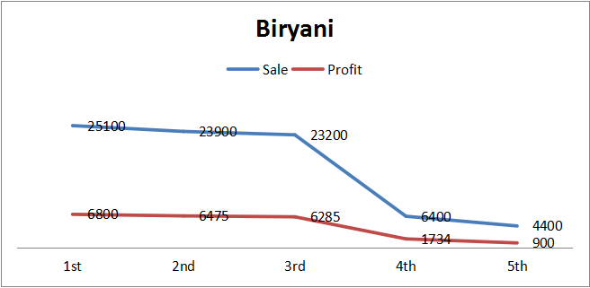
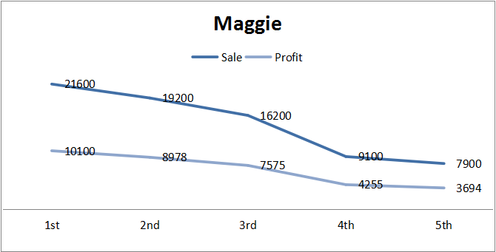
Solution Description
Price Comparison- Higher Quality – Not Good Sale- Constant
Profit/Sale- 27%
Sale/T.Sale – 24% Profit/T.profit – 19%
Solution Price – either same or reduced Quality – improve
Demand- constant so we can do some experiment with the taste like adding dry fruits
Complimentary- Fruit Rayta
Price Comparison- Same Quality – Comparable Sale- Reducing
Profit/Sale- 46%
Sale/T.Sale – 19% Profit/T.profit – 26%
Price – Same Quality – improve
Demand – can be increased if some additional variant can be added like cheese slice, mayonnaise , cooked or roasted maggi etc.
Packaging- Plastic free
For data click on- assignment 1.1.xlsx

Slide 6
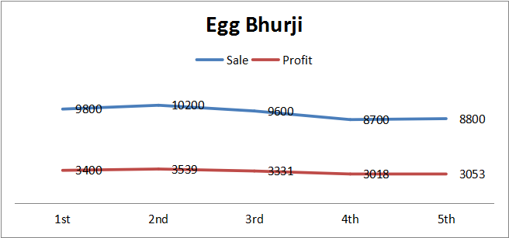
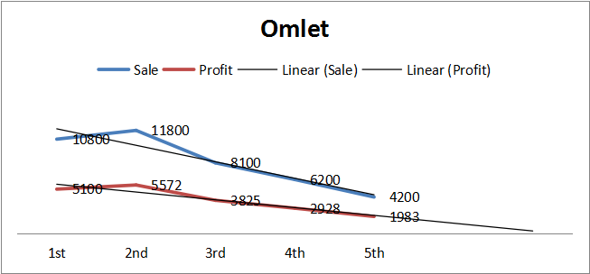
Solution Description
Price Comparison- Lower Quality – Not Good Sale- Constant
Profit/sale- 35%
Sale/T.Sale – 10% Profit/T.profit – 10%
Solution Price –Same or increased Quality – improve
Demand – constant but can be increased if some additional variant can be added like pav bhaji egg bhurji , broccoli egg bhurji , cheese egg bhurji etc.
Price Comparison- Higher Quality – Very Good Sale- Reducing
Profit/Sale- 47%
Sale/T.Sale – 10% Profit/T.profit – 14%
Price – either same or reduced Presentation- improve
Demand- can be increased by adding some additional variants by using green beans, onions, peppers, broccoli, cauliflower, spinach etc.Meat: cooked sausage, bacon, chicken, ham.
For data click on- assignment 1.1.xlsx

Slide 7
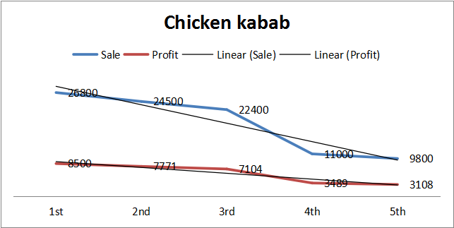
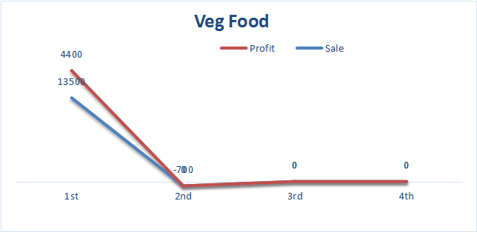
Solution Description
Price Comparison- Higher Quality – Very Good Sale- Constant
Sale/Profit- 31.7%
Sale/T.Sale – 24.5% Profit/T.profit – 22.7%
Solution Price – either same or reduced Presentation – improve
Demand – very much related to omlet by targeting Same customer. Meal can be added with little additional cost.
Price Comparison- Lower Quality – Comparable Sale- Constant
Sale/Profit- 32.5%
Sale/T.Sale – 4.5% Profit/T.profit – 4%
Price – either same or reduced Quality – improve
Stock Management- Improve
Presentation- two separate counter etc.
For data click on- assignment 1.1.xlsx

Slide 8
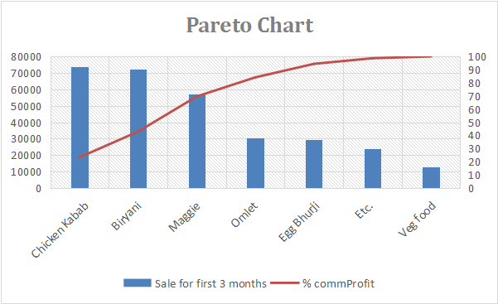
Solution Description
Additional Strategies:-
Tuesday and Thursday only veg
Weekend combo pack
Innovative idea must be introduced with wide food range
Assessing competitor strength and weakness
Unique name to stall as well as food items
Tie-ups with various food aggregator
Cashless payment mode
For data click on- assignment 1.1.xlsx

Slide 9
Business Impact
Customer footfall is improved.
New variety with quality on check gave the new dimension to the business.
Presentation gave the existing stuff to look good resulting increase in the sale.
Investment risk is reduced by some margin.
Stock management is improved.
Profitable food types are determined and all the factors affecting profit are taken into consideration so that ROI is always on the positive side.

Slide 10
Thank You

